Slide 1
Pierre Dansereau
Ecology and sociology synthesis
Concept Inscape/Landscape
for the project management
Miloslav Lapka

Slide 2
Landscape / Inscape
External landscape – internal landscape
“Landscape painting is about the changes in the human inscape from prehistoric to modern times”.
Internal landscape, mental map – inscape:
Inscape may also change, independently of the physical context, under the influence of socio-cultural factors. These changes may have their impacts on the external landscape – land-use, planning, landscape design…leading to further action…
Pierre Dansereau, 1975. Inscape and Landscape. Columbia University Press, New York, London, 118p.

Slide 3
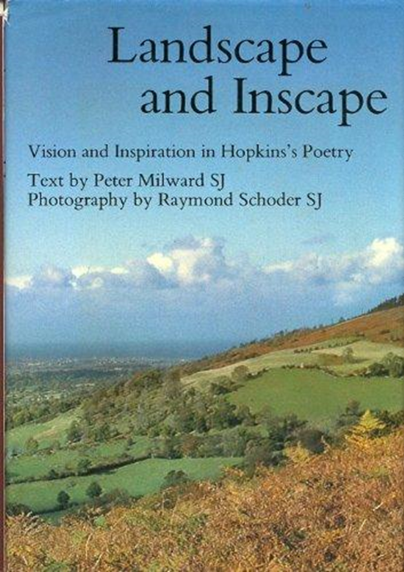


Ad 1. Introdictrion: Story of popularity

Slide 4
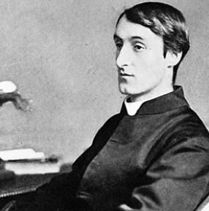
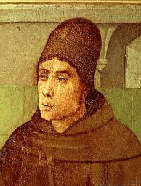
Inscape as a metaphor and pre-scientific term
Inscape and Instress
Inscape is an individual identity. Every being has its identity
Instress – energy united individual inscapes together in one system.
Instress of Inscapes – is the unit of the world.
Gerard Manley Hopkins 1844 – 1889
Hallowed Jan Duns Scotus
c. 1266 – 1308
The ash-tree growing in the corner of the garden was felled. It was lopped first: I heard the sound and looking out and seeing it maimed there came at that moment a great pang and I wished to die and not to see the inscapes of the world destroyed any more. Journal 8th April 1873 (deník)

Slide 5
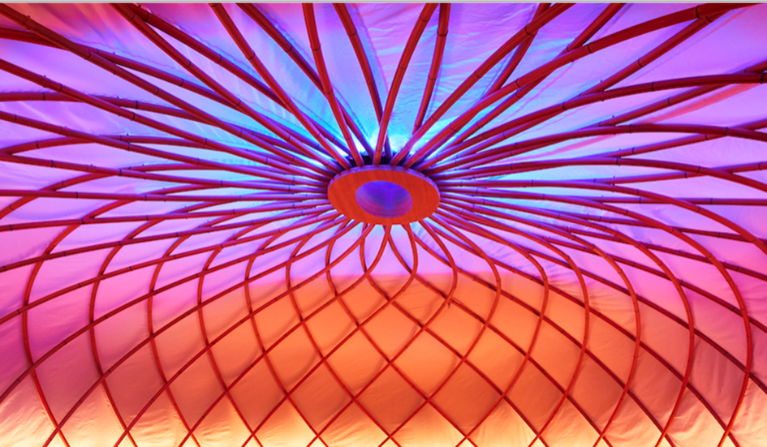
Inscape like a brand
INSCAPE delivers immersive meditation and relaxation experiences - in our NYC studio and iOS app - by merging tradition, modern thinking, and of-the-moment technology

Slide 6


Inscape like a brand (continue)
INSCAPE s.r.o., Praha - Obchodní rejstřík firem

Slide 7
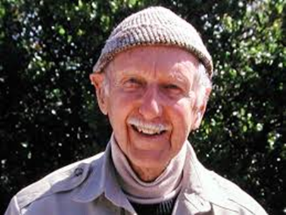
Ad 2.Inscape as a scientific term
Landscape perception
Pierre Dansereau
Distinguishes between landscape and landscape perception.
Basic methodological issue. Near to sociology.
„Man has had a selective perception of the world about him and it turn a highly discriminating way of modelling the landscape to match his inner vision (Dansereau, Introduction str. 2).
Inscape – is landscape perception influenced by social and culture conditions.
There are landmarks of this itinerary:
Pierre Mackay Dansereau (1911- 2011)

Slide 8
Ad 3. Inscape/Landscape concept and its potential
„Indeed I view the inscape/landscape process as a cycle“ (Introduction str. 2)
a) Inscape and landscape build system
b) Inscape is always selective
Inscape is the result of human perception of landscape – the way of understanding landscape.
Inscape is no static perception, this is result of processed:
Perception
Training education
Research
Energy for changes Power
Planning
Management

Slide 9
Ad 3. Trophical Levels in Landscape and Inscape
Six trophical levels
minerotrophy, fytotrophy, zootrophy (1), zootrotrophy (2), investment, control
Legend:
The main flow of energy (in the middle)
Energy resources (left part)
re-investment (right part)
import (left edge)
export (right edge)
Source: (Dansereau, ibid, str. 48)
Comments: one unit for social, economical and biological and geological processes.

Slide 10
Ad 3. „5 E“.
Every landscape, every trophic level is determinated by 5 E
(
(Dansereau ibid, pp. 85-86).
Ecology (ecosystems in a landscape)
Etology (life style and knowledge of human population using the sources from ecology
Economy (landscape management, from ancient gatherers to urbanization, industrialization and export – import, capital investigation)
Etnology (race, gender, culture)
Ethics (moral values a and way of life influenced exploitation of natural resources)

Slide 11
Ad 4. Possibility of an implementation in Landscape Research
Research questions:
What energy transfers are involved in the succession from wild to rural to industrial or urban landscape?
(L. typology)
What system of values are the basic motive of our management practice? (rural development and its discourse: developing or nature and culture conservation)
What is the present perception of existing landscapes that sustain the forms of cycling that we are now witness? (methodological approach of sociology consumption – post – consumption society, NEP, HEP environmental sociology)
What changes can we foresee in human motivation and interaction that promise hope for a better environment? (concepts of sustainable development, green economy, bioeconomy
(According: Dansereau, p. 94)
„Inscape is so strong in recourses distribution like an earthquake, flood and dieses“.
(Dansereau, Science for Better Environment, 1975, p. 242)

Slide 12
Ad 5. Critical disscusion +
Inscape/Landscape system is the complex definition of landscape.
Landscape is not an independent system on human society, on the other hand landscape is not the only symbolic construction
Inscape/Landscape concept allows methodologically understand continuity and discontinuity of a given landscape – decline of rural landscape, its reconstruction, revitalization, program of rural development etc.
Concept of reality and reality perception like a two different thing is not completely new
Immanuel Kant in philosophy.
Social constructivism in sociology.
But new in terms of socio-ecological systém.

Slide 13
Ad 5. Critical disscusion -
Driving forces from global socio- economic environment
In Europe it is demography, geopolitics, technology, global climate changes
(Klijn, Vos, 2004).
Inscape individual level:
Inscape/Landscape, how my inscape is transformed into a group or national or global inscape?
Political decisions: How political decisions became a part of Inscape/Landscape system?

Slide 14
Ad 6) Conclusion – system of Landscape/Inscape
Inscape | Perception Training education Research Energy for changes Power Planning Management „landmarks“ | Landscape
Ethics Etology Ethology Economy Ecology “5 E“ | What energy transfers are involved in the succession from wild to rural to industrial or urban landscape? What system of values are the basic motive of our management practice? What is the present perception of existing landscapes that sustain the forms of cycling that we are now witness? What changes can we foresee in human motivation and interaction that promise hope for a better environment? Basic research questions | Minerotrophy Fytotrophy Zootropfy (1) Zootrophy (2) Investment Control „trophical levels“

Slide 15
Pierre Dansereau – references analyse

Slide 16
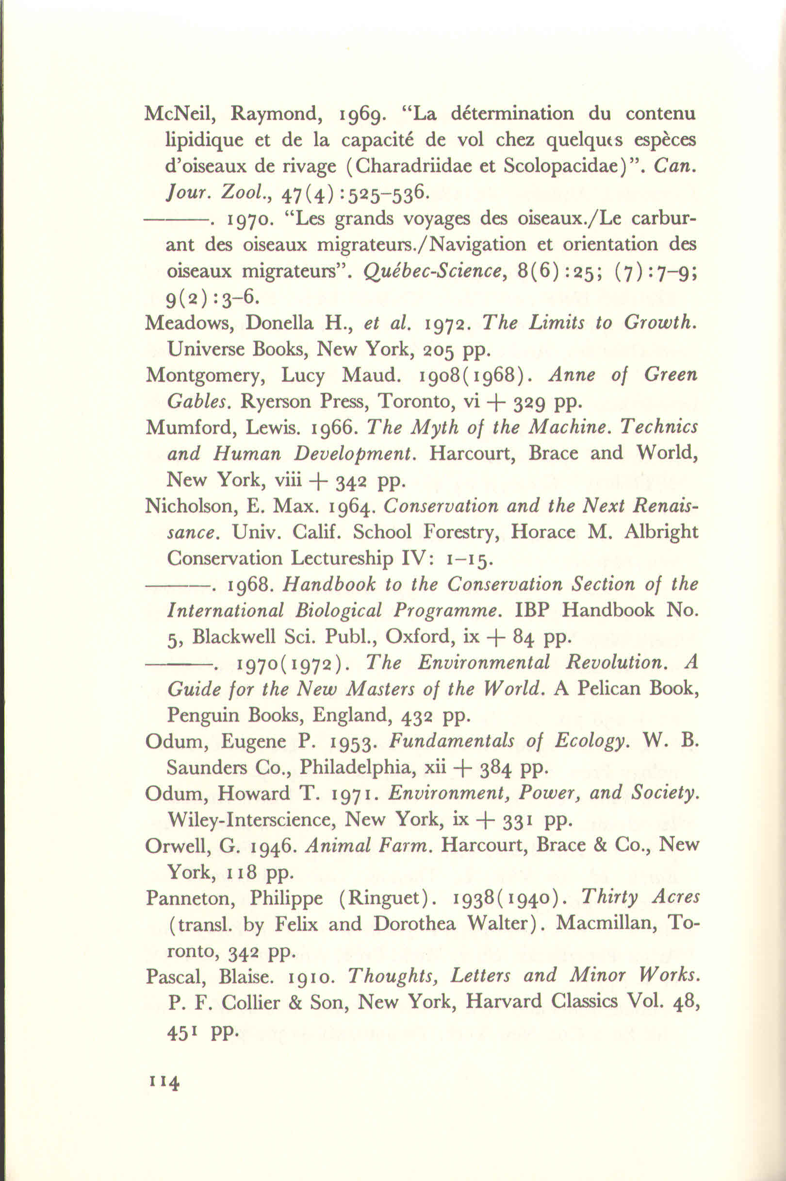
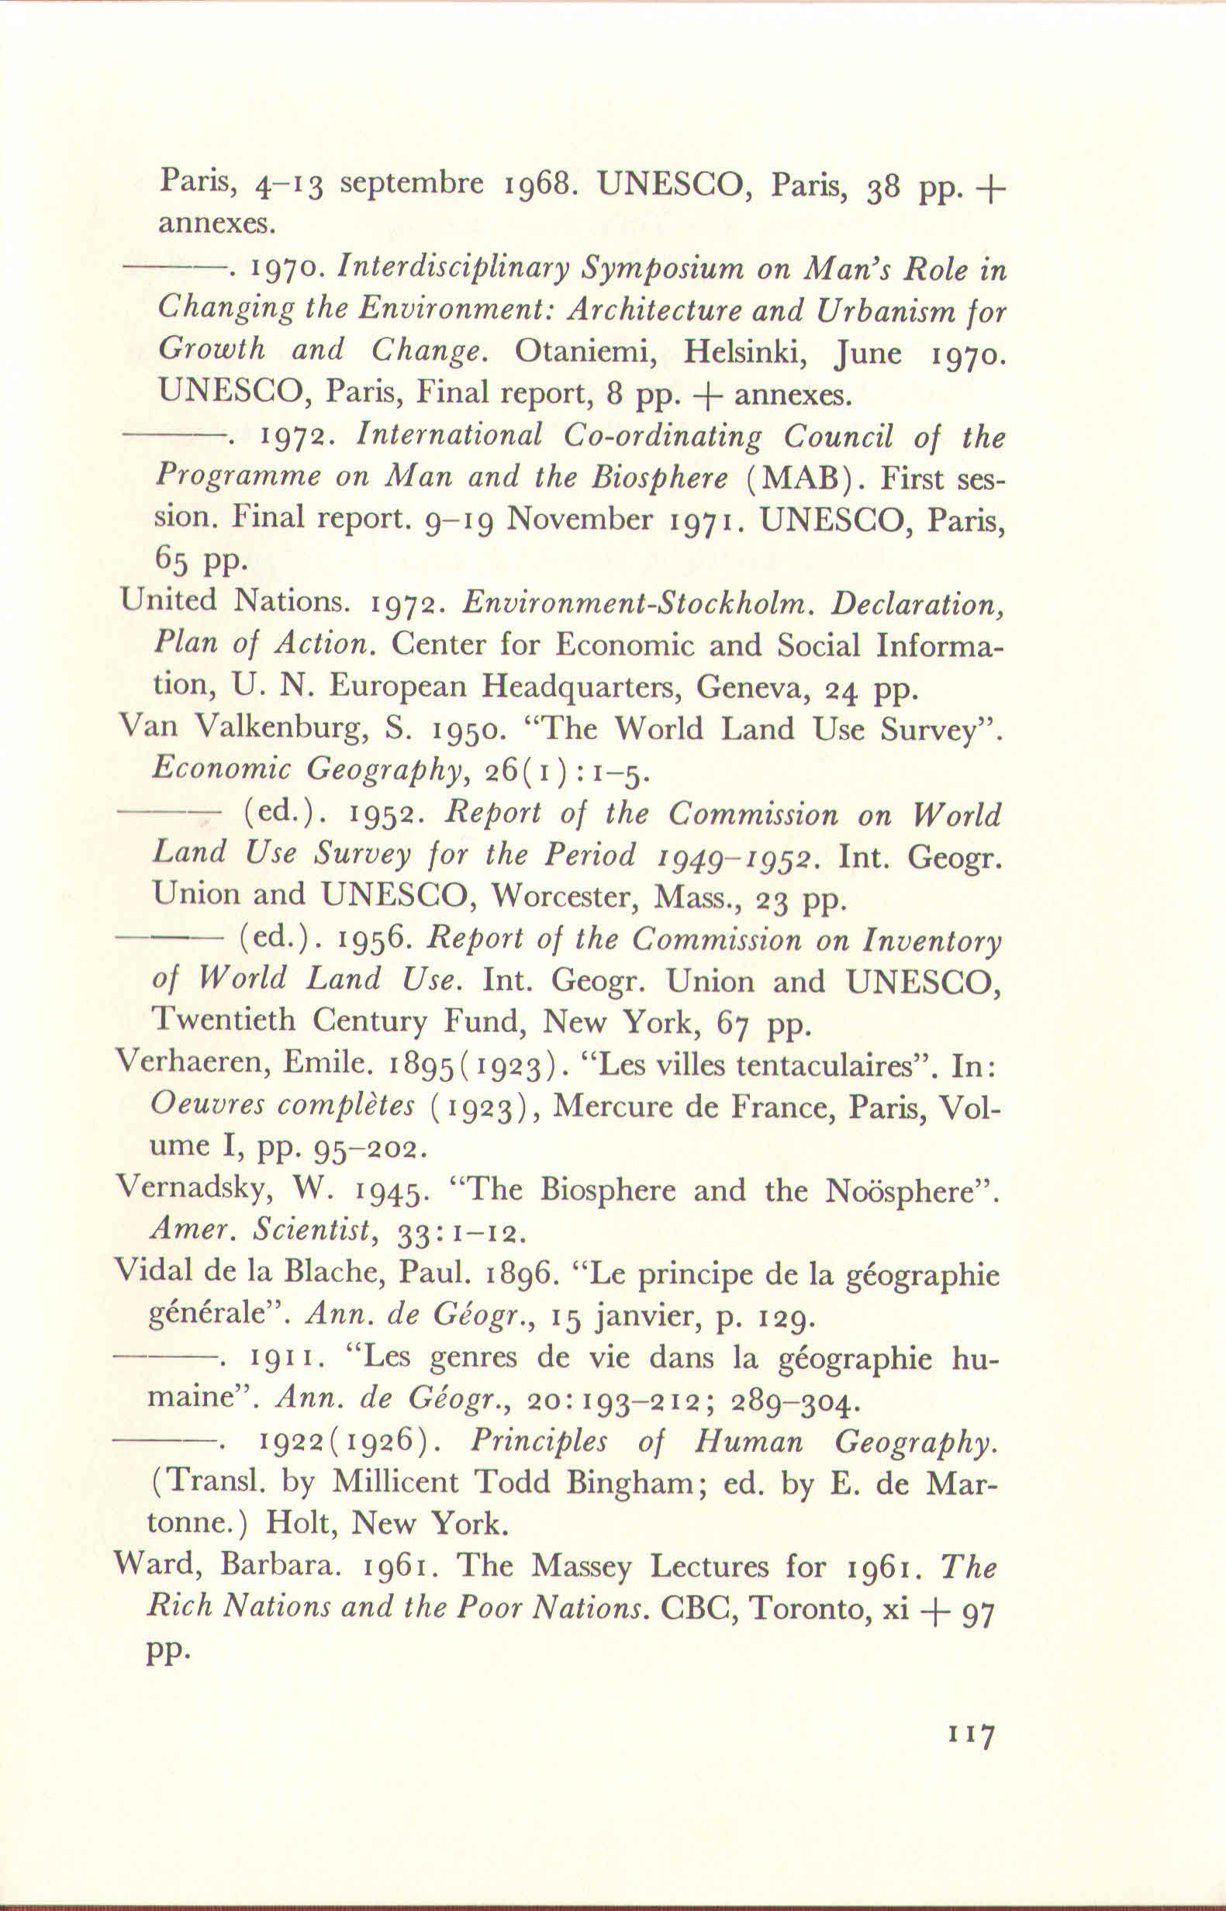
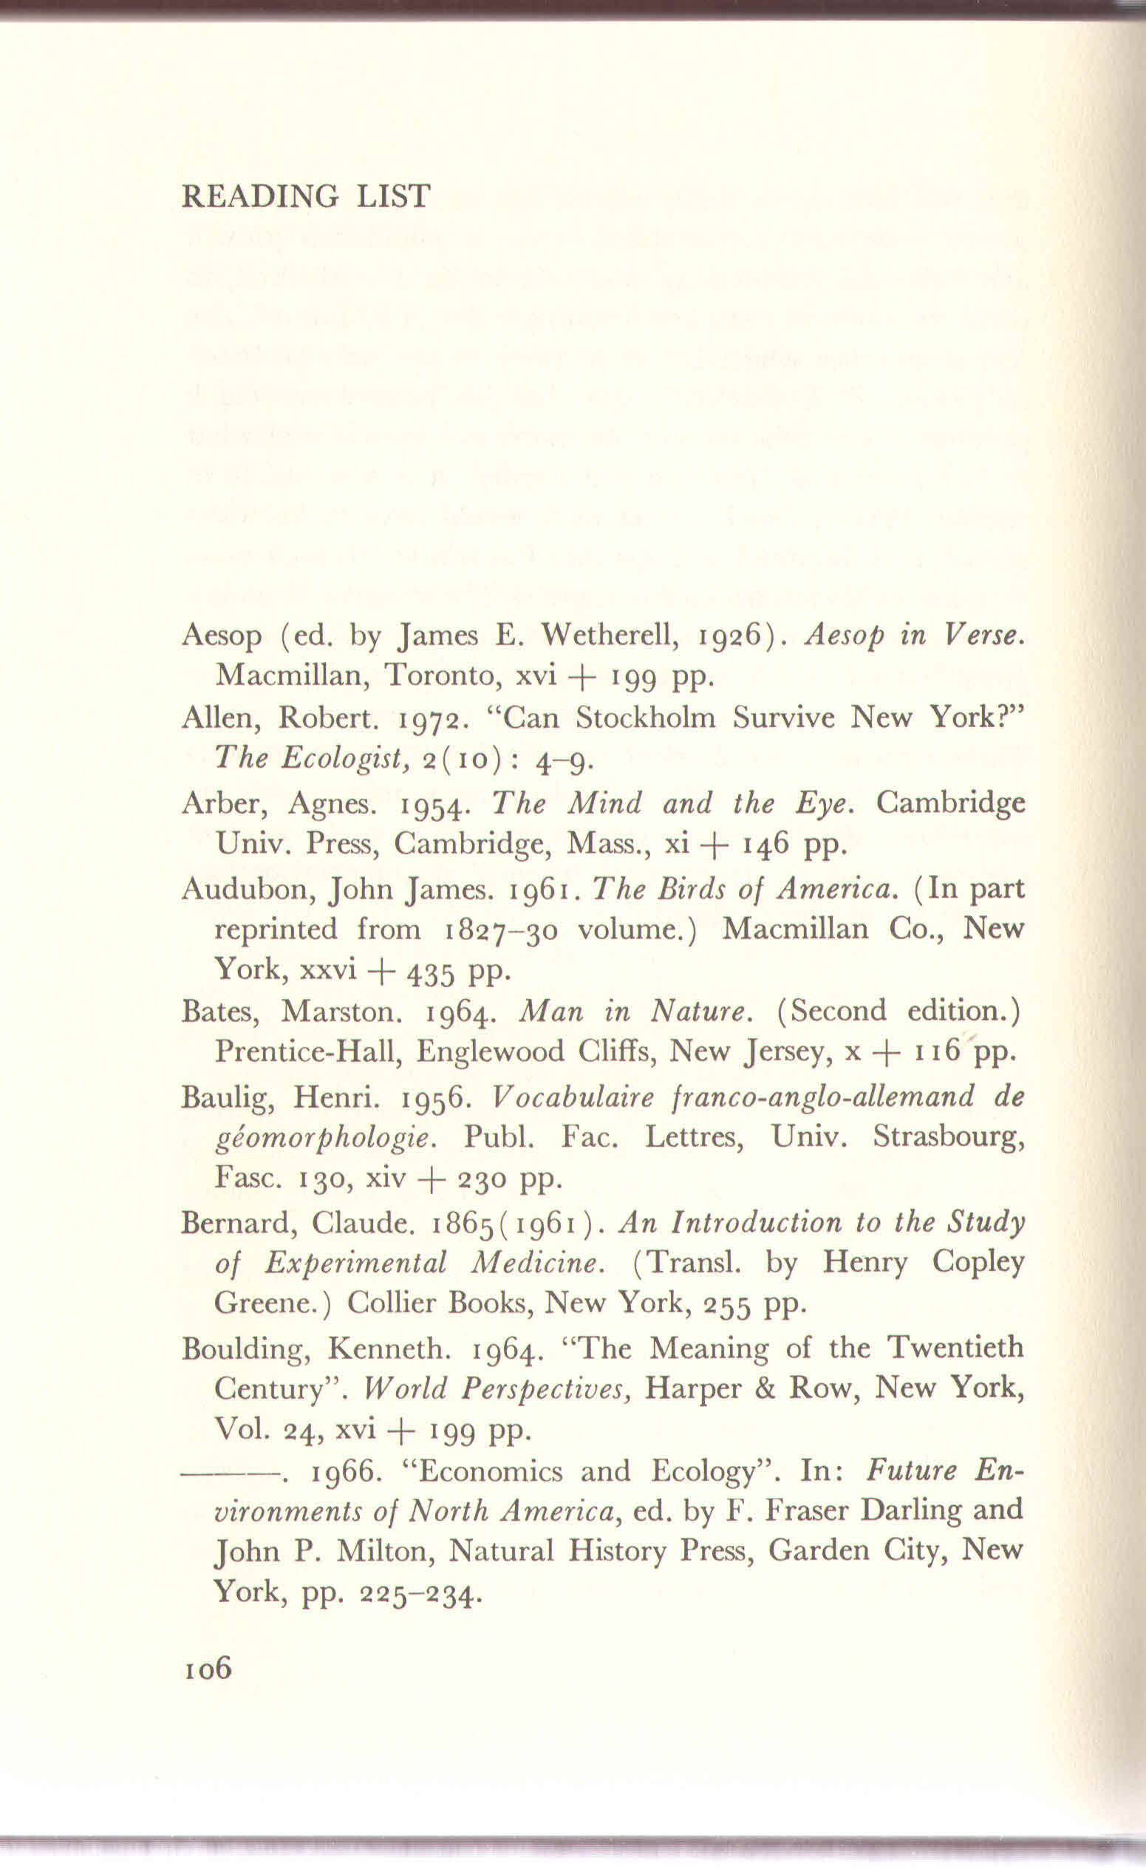
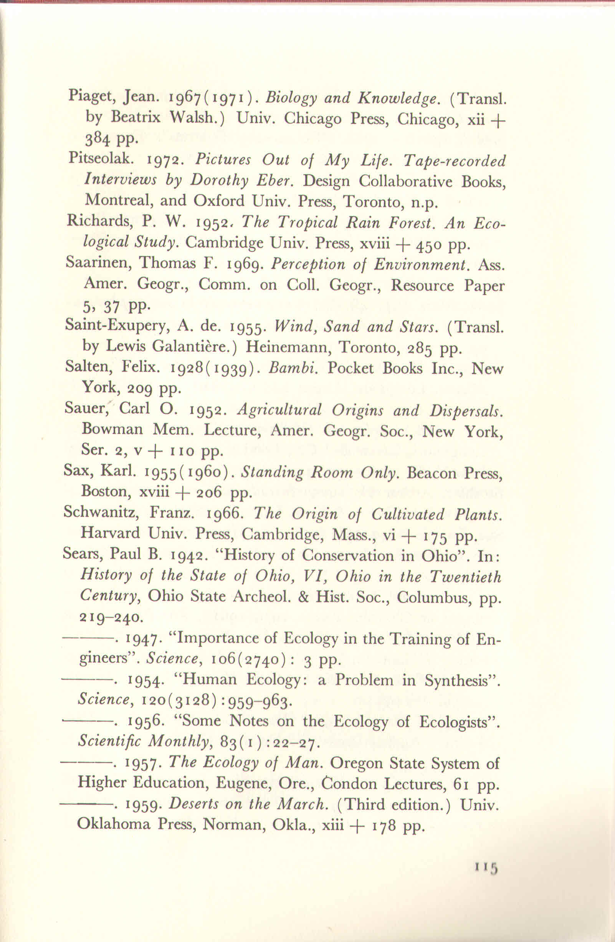
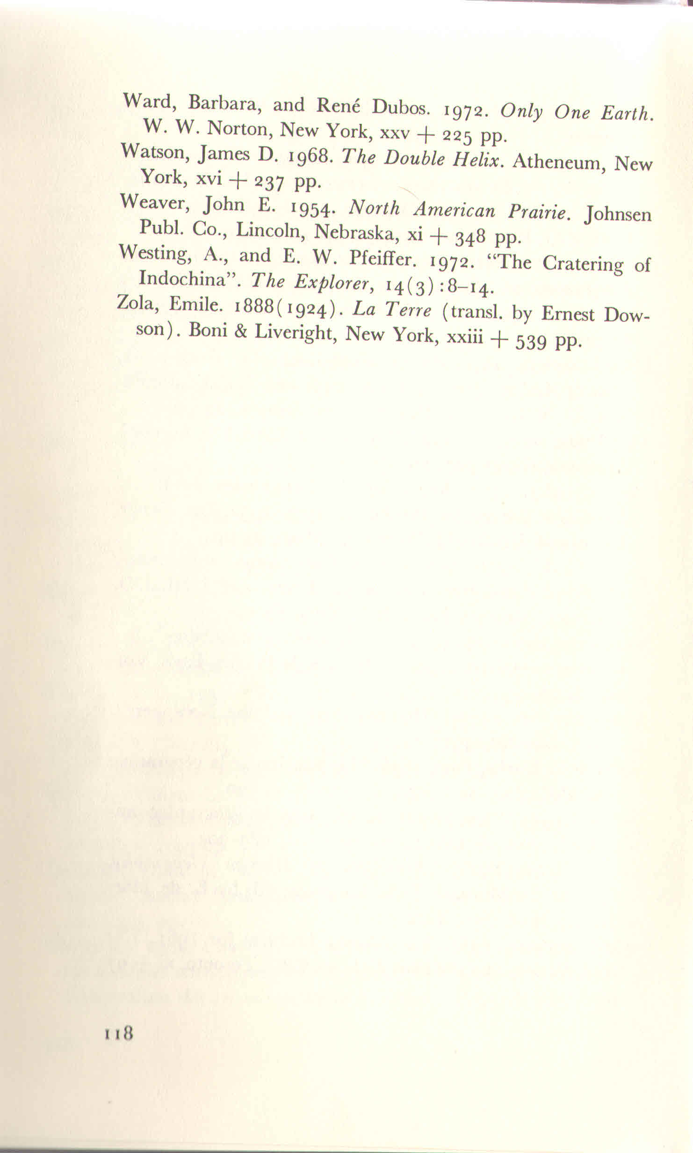
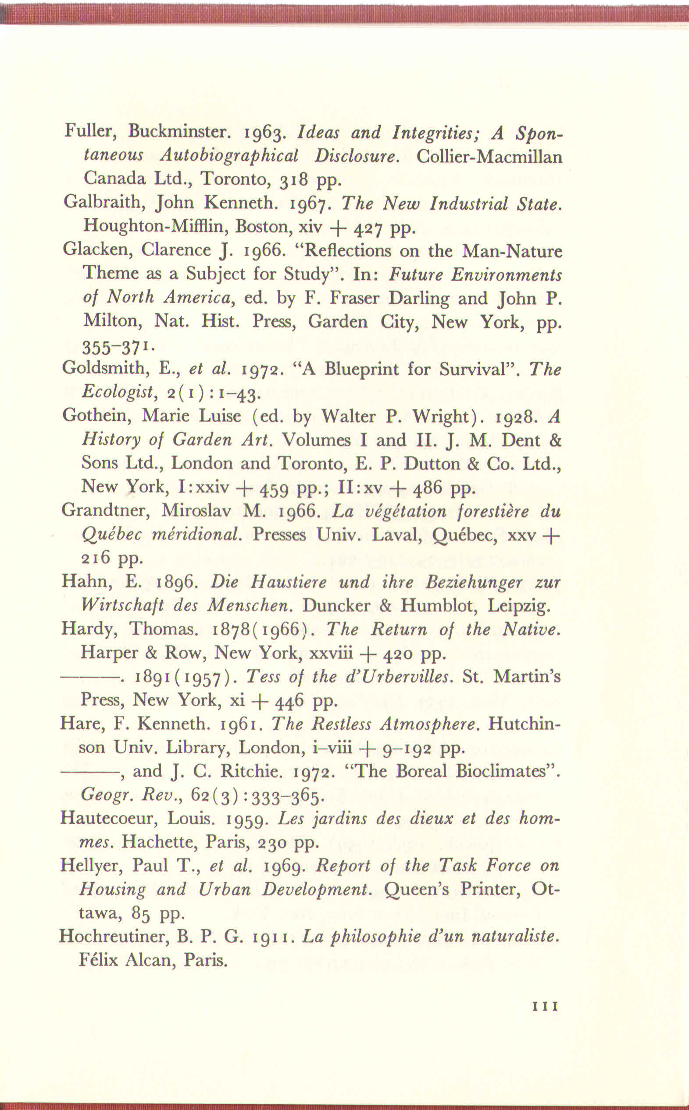
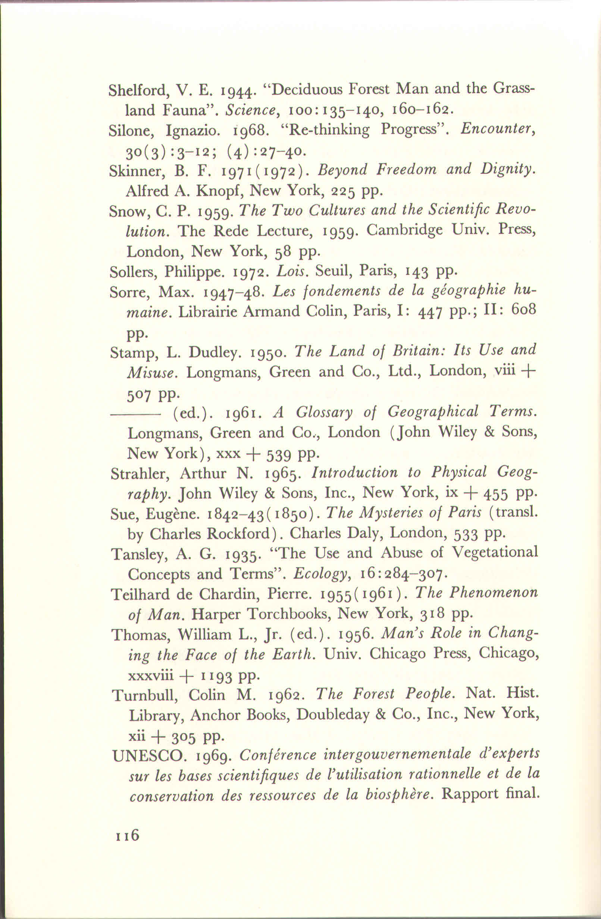
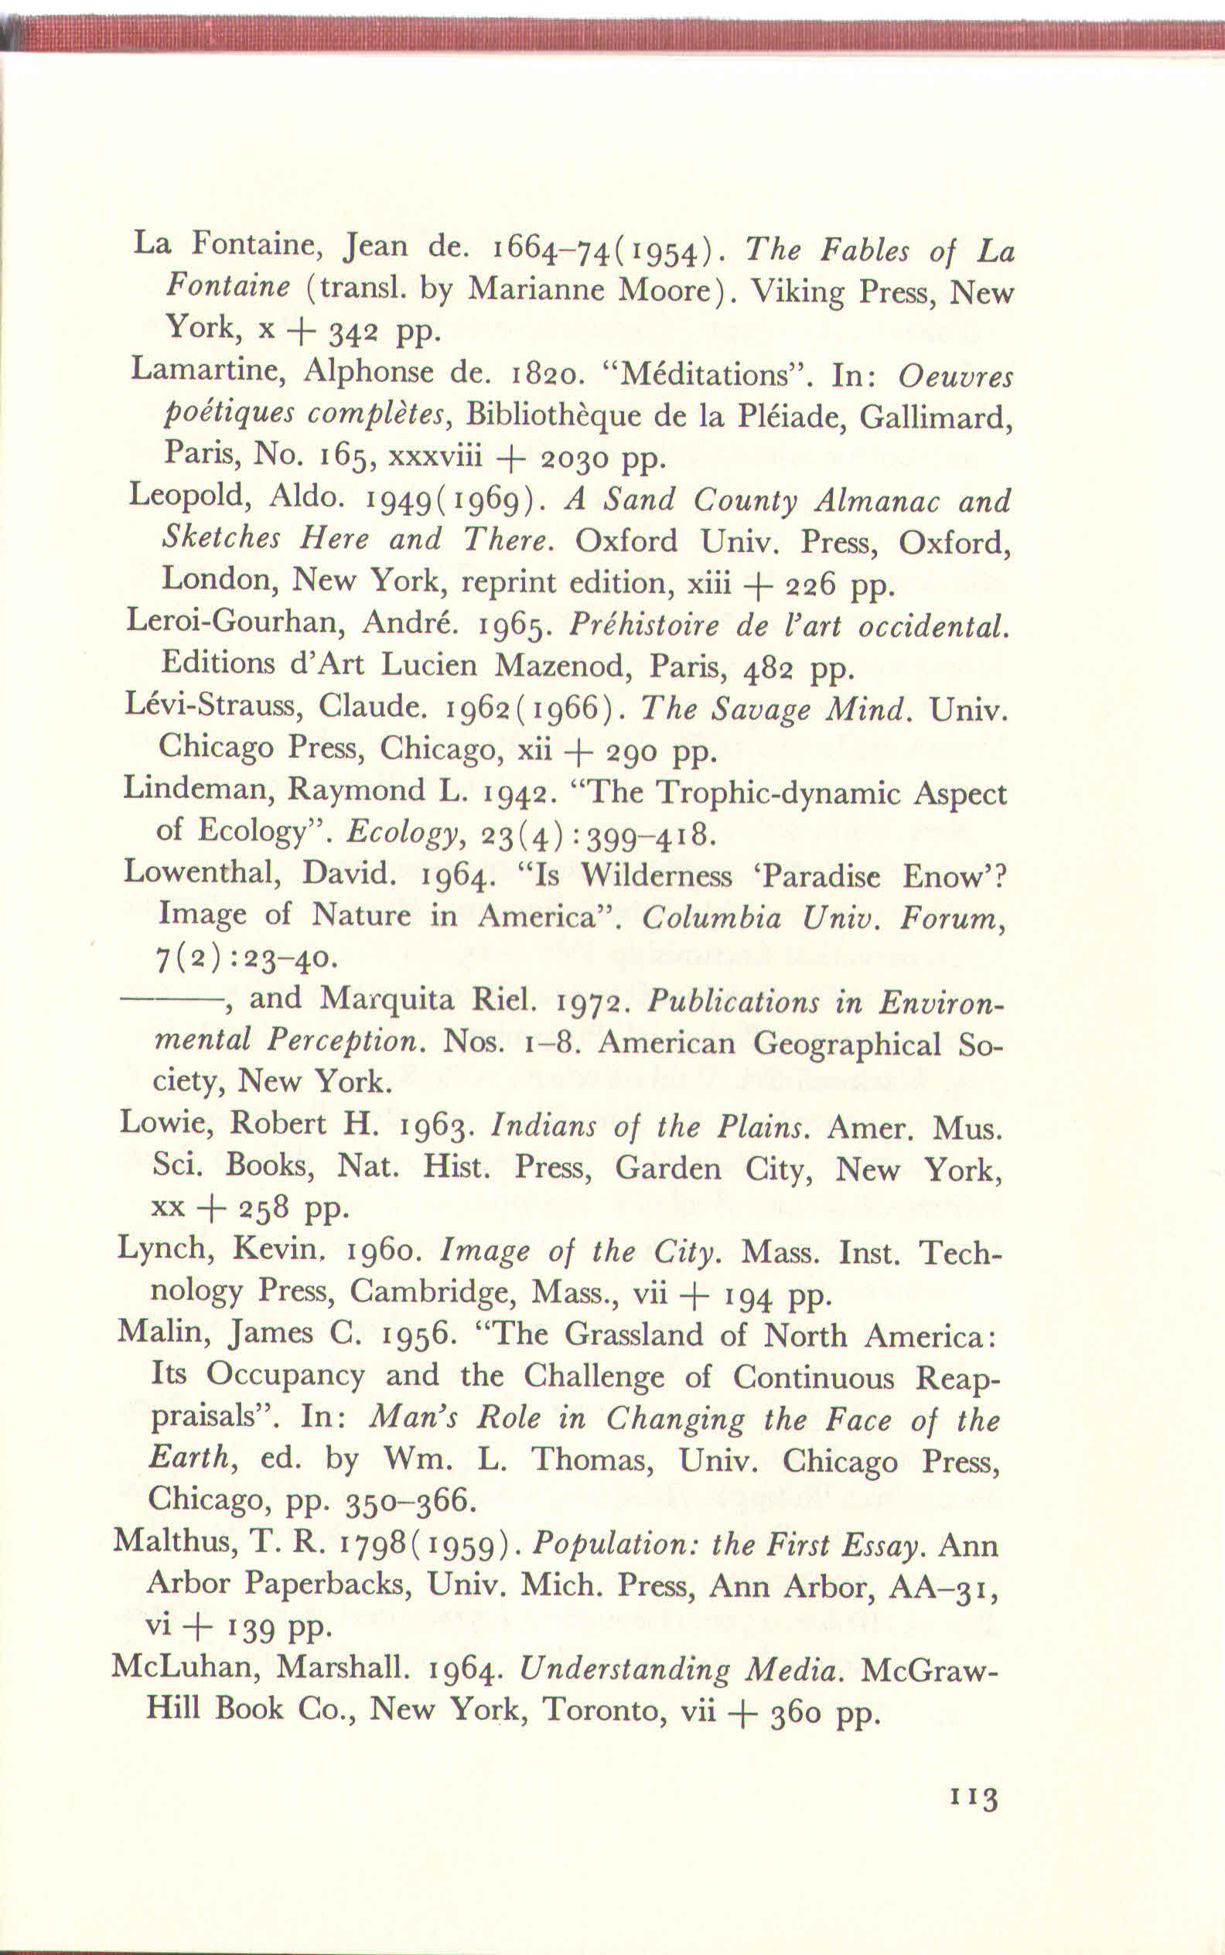
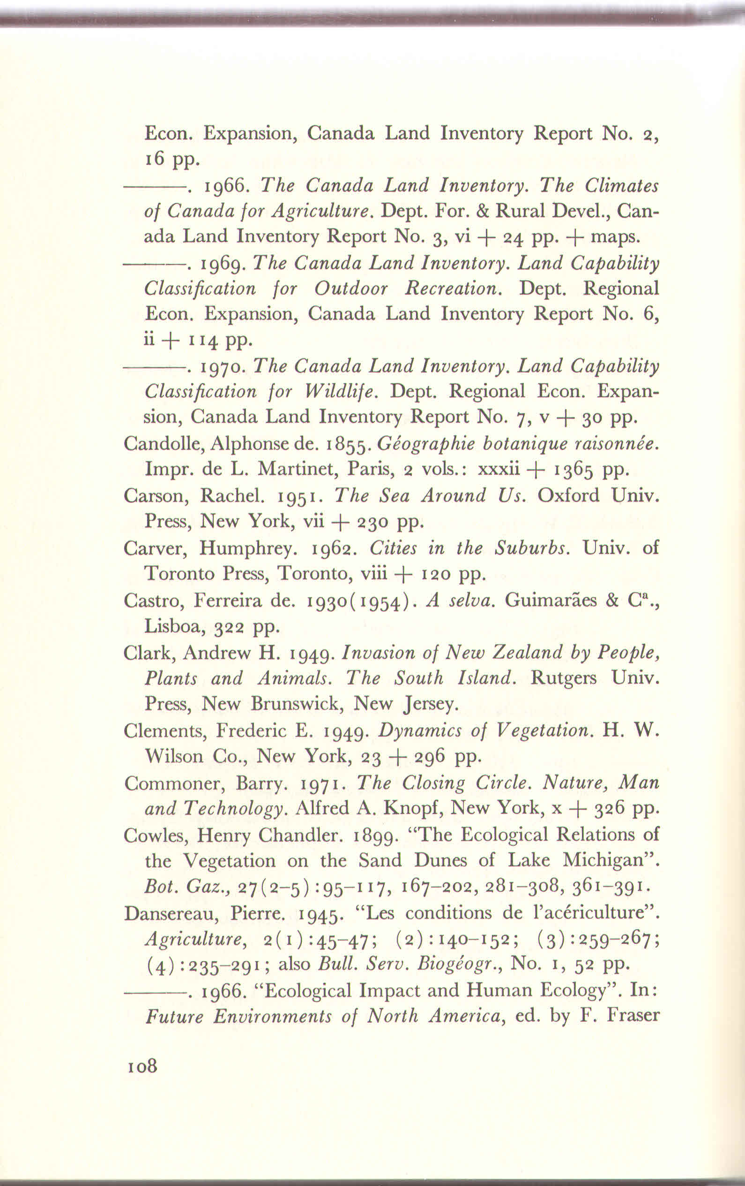
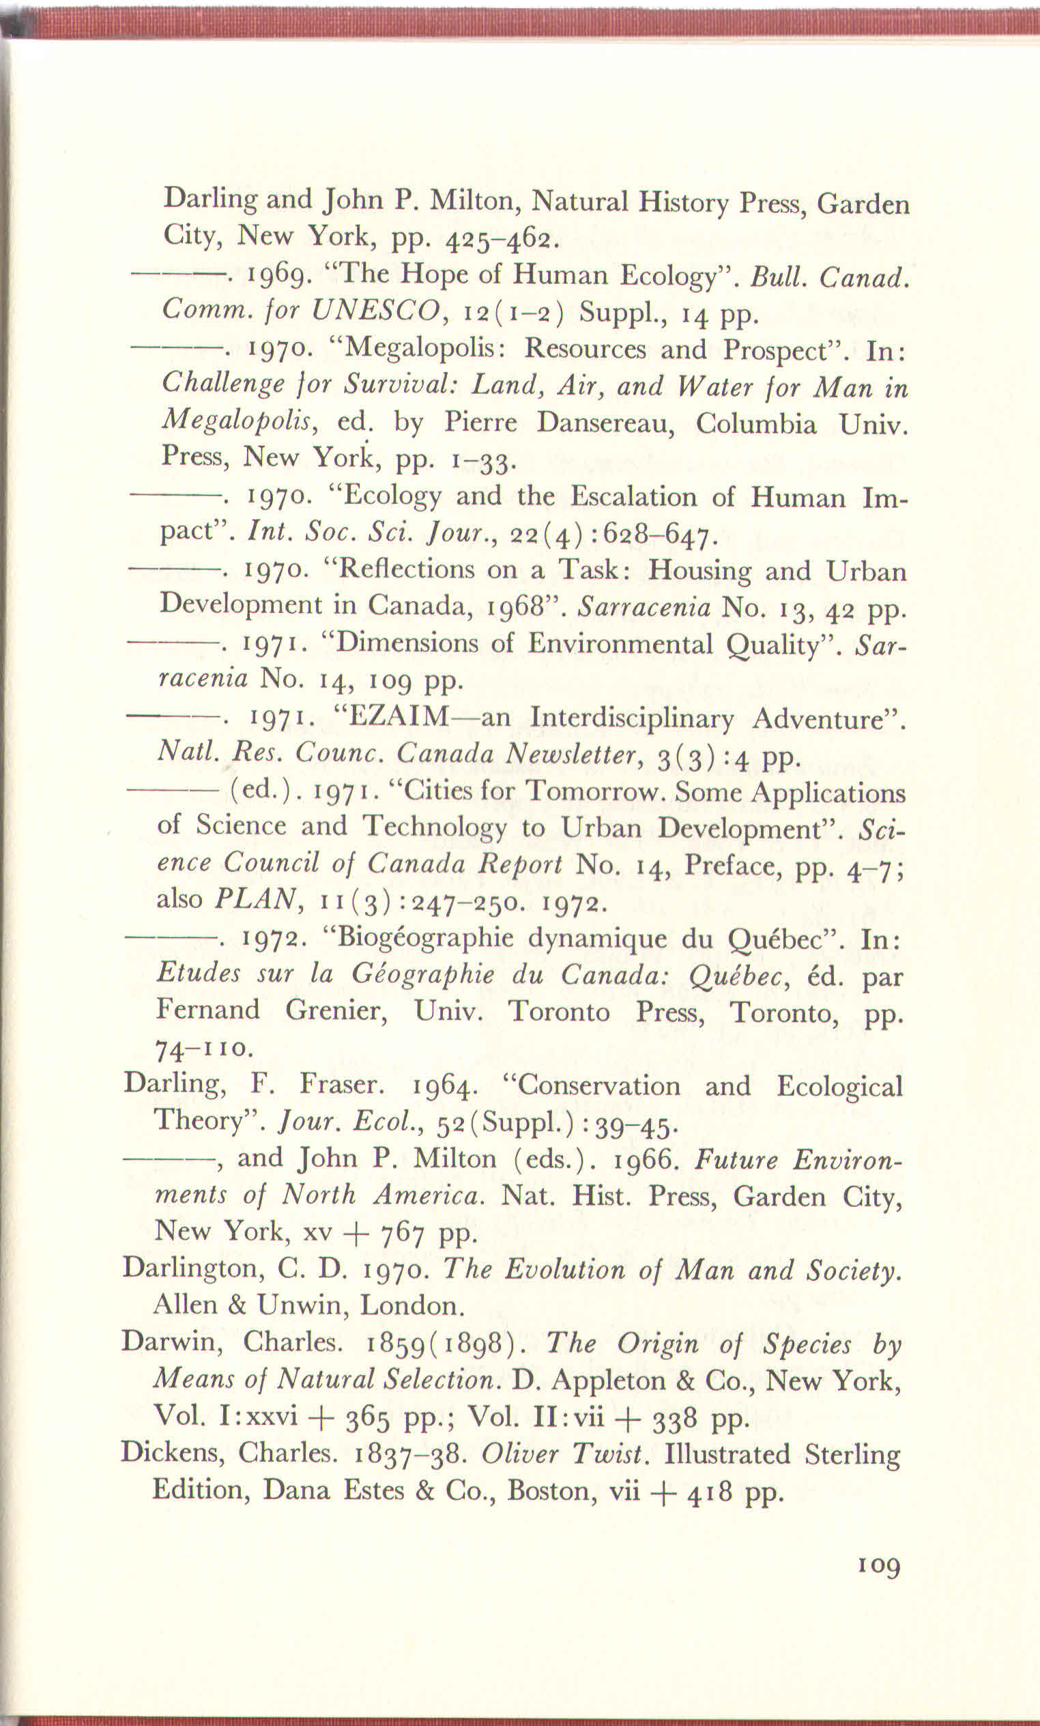
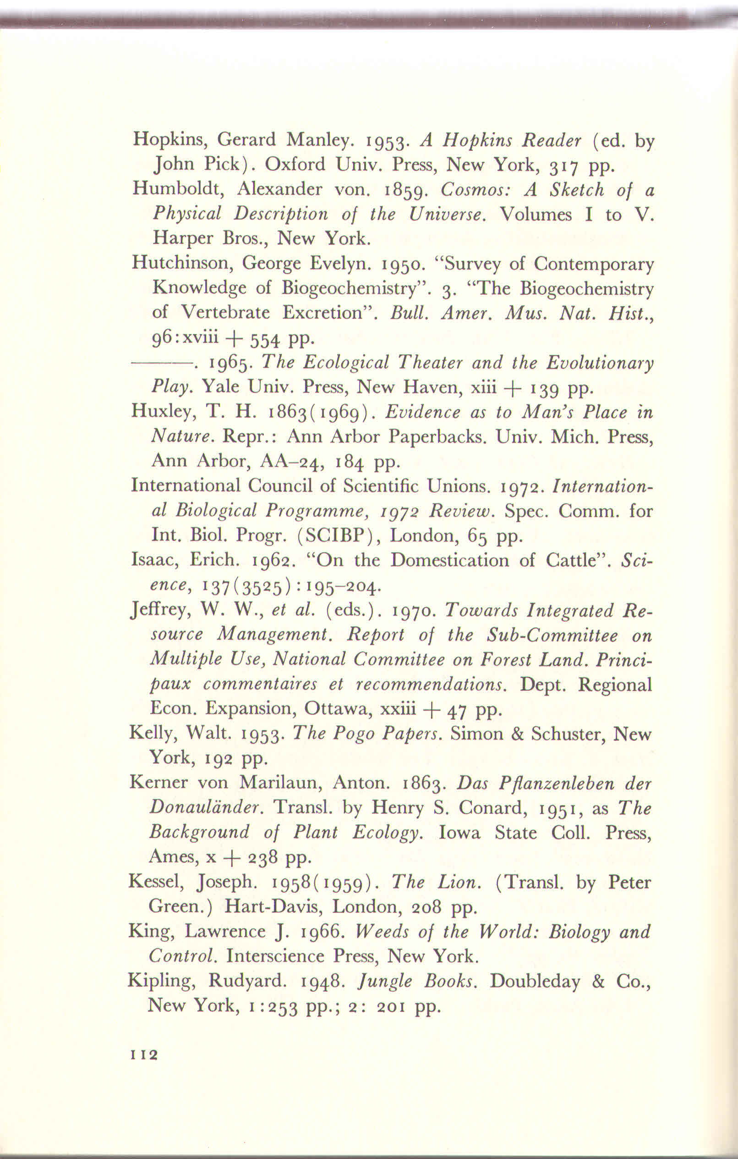
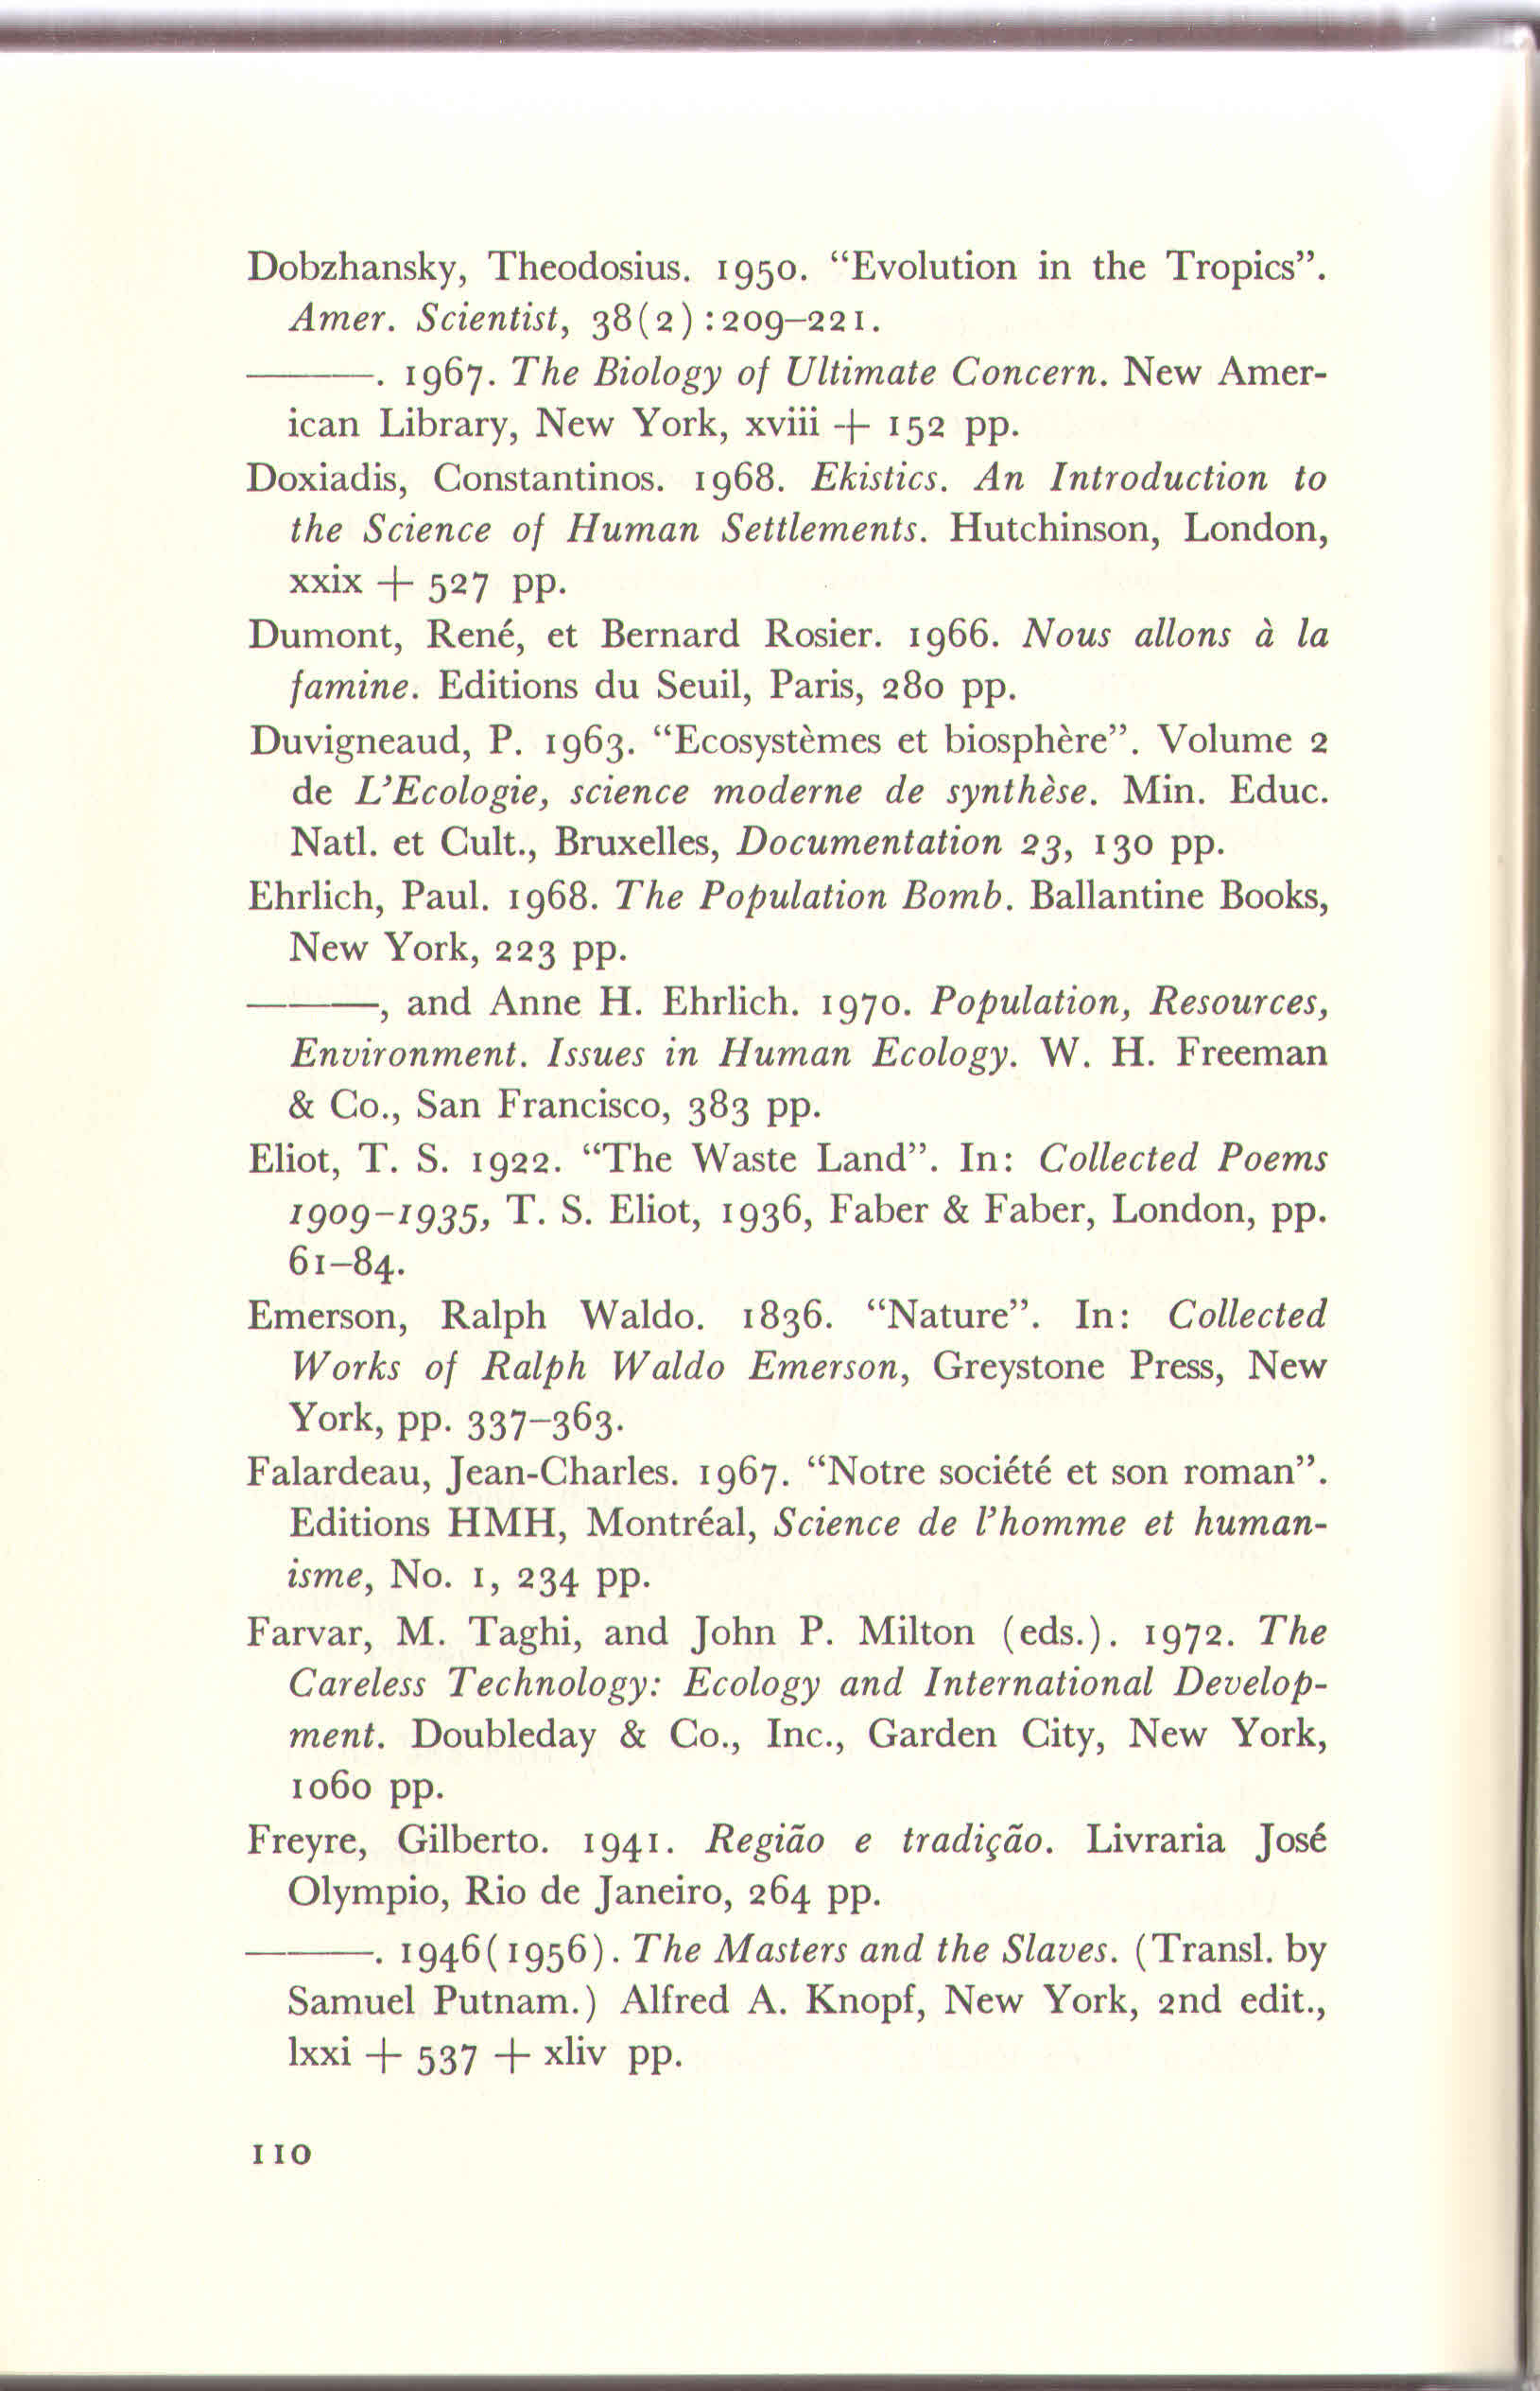
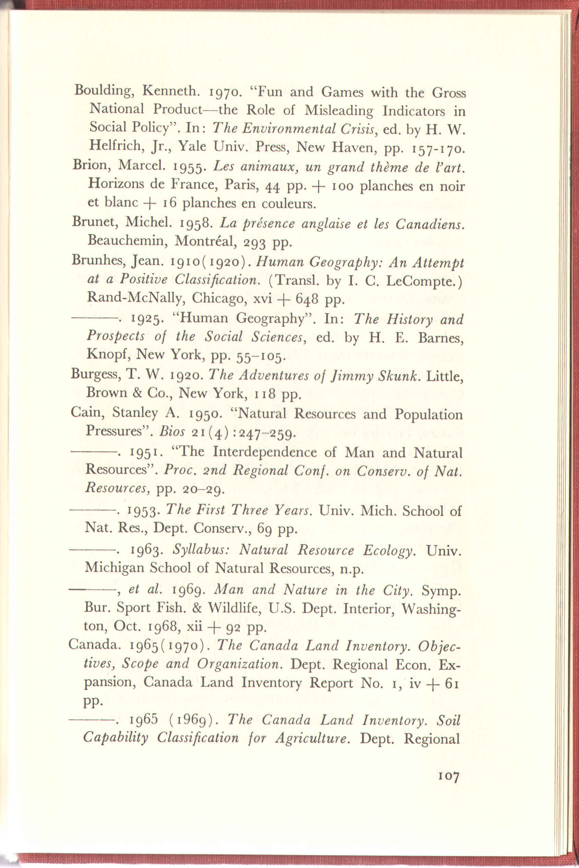

Slide 18
Ad7. Vybrané zdroje
AUDET, R. (2012): “ L'écologie humaine de Pierre Dansereau et la métaphore du paysage intérieur ”, Natures Sciences Sociétés 1/2012 (Vol. 20) , p. 30-38
BERGER, P., T. LUCKMANN (1966): The Social Construction of Reality. New York: Doubleday. Česky: Peter L. Berger, P., Thomas Luckmann (1999): Sociální konstrukce reality. Pojednán o sociologii vědění. Centrum pro studium demokracie a kultury. Brno.
CÍLEK, V., (2005): Krajiny vnitřní a vnější. 2 doplněné vydání. Dokořán, Praha
DANSEREAU, P., M., (1975): Inscape and Landscape: The Human Perception of Environment. Columbia University Press, 1st American edition. New York & London.
DANSEREAU, P., (1957): Biogeography: an ecological perspective. The Ronald Press Co., New York.
DANSEREAU, P., (1966): Ecological Impact and Human Ecology. In Future Environments of North America. F. Fraser Darling and John P. Milton eds., Natural History Press, Garden City, New York, str. 425-462.
GREIDER, T., GARKOVICH, L., (1994): Landscapes: The Social Construction of Nature and the Environment. Rural Sociology, Vol. 59, No. 1., str. 1–24.
HAJER, M., (1996): Ecological Modernization as Cultural Politics. (Scott Lash, Bronislav Szerzynski, Bryan Wynne eds.) Risk, Environment, and Modernity. Towards a New Ecology. Sage, London, str. 246-256.
KLIJN, J., A., (2004): Driving forces behind landscape transformation in Europe, from a conceptual approach to policy options. The New Dimensions of the European Landscape. (Edited by R.H.G. Job Jongman). Springer, str. 201-2019.
LAPKA, M., CUDLÍNOVÁ, E., RIKOON, J., S. and MAXA, J. (2001): Integrating nature, culture, and society: the concept of landscape field. Ekológia (Bratislava), No.. 20, no.1, str. 125-138 a
LAPKA, M., CUDLÍNOVÁ, E. (2015): Land, People, and Art. An Attempt to Renew Social Identity in The Czech Republic. Culture and Sustainability in European Cities: Imagining Europolis. (Svetlana Christova, Milena Dragicevič Šešič, Nancy Duxbury, edit). Routledge. str. 206-218.
NAVEH, Z. (2007): Transdisciplinary Challenges in Landscape Ecology and Restoration Ecology. Springer. Str. 263).
PICKETT, S., T., A., CADENASSO, M., L., GROVE, J., M., (2004): Resilient cities: meaning, models, and metaphor for integrating the ecological, socio-economic, and planning realms. Landscape and Urban Planning, Vol. 69, No. 4, str. 369-384.
RAPPAPORT, R.A., (1979): Ecology, Meaning and Religion. Richmond: North Atlantic Books.
SAUER C. , O, (1925): The Morphology of Landscape. University of Californina Publication in Geography. No2p 19-53. In. Foundation Papers in Landscape Ecology (2007): (John A. Wiens, Michael R. Moos, Monica G. Turner, David J. Mladenoff edit.) Columbia University Press, New York.
SCIENCE FOR BETTER ENVIRONMENT, (1975): Proceedings of the International Congress on the Human Environment (Kyoto, 1975), Pergamon Press. Str. 242 –
THE 1972 CBC MASSEY LECTURES, "Inscape and Landscape„ http://www.cbc.ca/radio/ideas/the-1972-cbc-massey-lectures-inscape-and-landscape-1.2946818

Slide 19
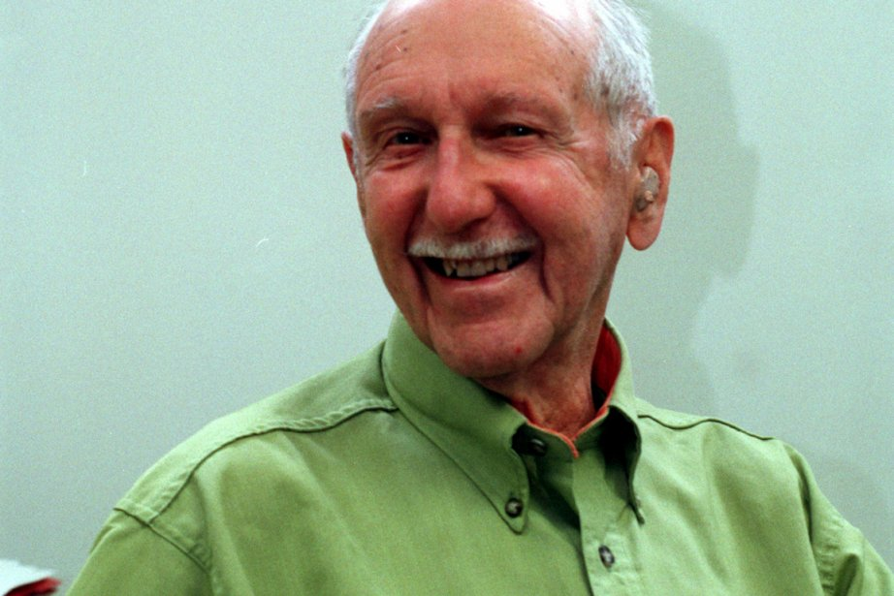
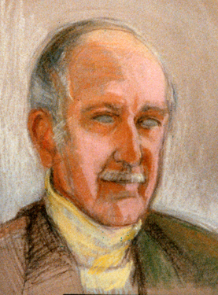
Thank you for your attention

